Slide 1
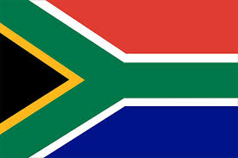

SOUTH AFRICA
By: Kendra, and Zankia

Slide 2
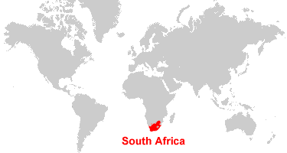
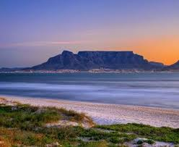
Country background
Language
South Africa is one of the countries known for language diversity, they have 12 official languages. They are divided into 3 main groups Bantu language, Germanic language, and sign language.
Ethnicity
black 75.2%, white 13.6%, Racialized person 8.6%, Indian 2.6%
Religions: Christian 68% (includes most whites and Coloreds, about 60% of blacks and about 40% of Indians), Muslim 2%, Hindu 1.5% (60% of Indians), indigenous beliefs and animist 28.5%
South Africa is known as one of the most beautiful countries in the world
Notes:
zankia

Slide 3
Global Issue
Income Inequality & Poverty
Notes:
Kendra

Slide 4
Country’s response
Notes:
zankia

Slide 5
Consequences
Notes:
kendra

Slide 6
Canadian comparison
Notes:
zankia,kendra

Slide 7
Sites!!
Notes:
Kendra,zankia

